Slide 1


The Battle of the Neighborhoods (2)
Segmenting and Clustering the city of Edinburgh

Slide 2
Business Problem
Chain of bakeries planning to expand to Scotland
Two large Scottish cities:
Edinburgh selected – festival foot traffic
Favourable rates & policies
Potentially cheaper location

Slide 3
Data
'2020-2 Scottish Postcode Directory Files' dataset
Provided by National Records Scotland
Location of interest: Edinburgh
Foursquare API

Slide 4
Methods
Python packages
Pandas – using dataframes
NumPy – using arrays
Sci-kit learn – ML algorithm
Geopy – obtain coordinates
Folium – create maps
K-Means clustering algorithm
Foursquare API

Slide 5
Results
Cluster Label | Key types of Shop/Venue | Colour Legend
0.0 | Gourmet Shop | Red
1.0 | Ice Cream Shop; Tea Shop | Purple
2.0 | Bakery | Blue
3.0 | Creperie; Dessert Shop; Tea Room | Green
4.0 | Gelato Shop | Orange

Slide 6
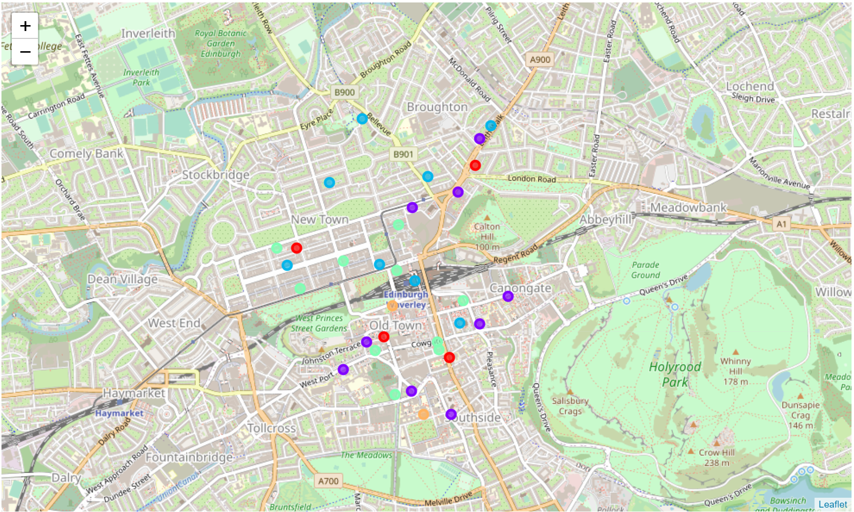

Slide 7
Challenges faced…
Number of clusters were not optimised
K-Means clustering
Size of the original dataset
Limited number of Foursquare calls
Coding inconsistencies/errors in Foursquare venues
Thai restaurant?

Slide 8
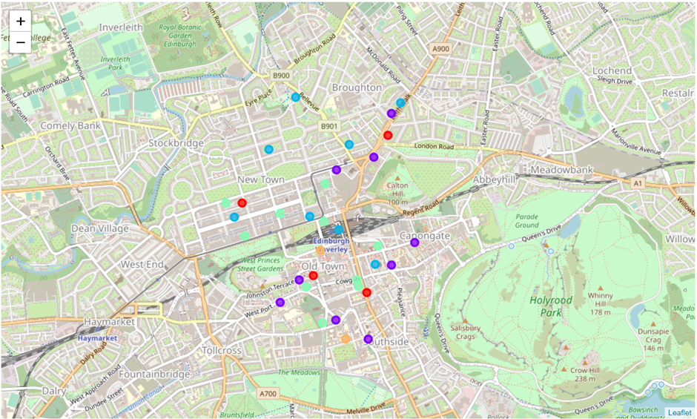
Recommendations
The best location for a new bakery would be away from the blue and green clusters on the map!

